Slide 1
UVStocks
Trent, Jared, Kyler, David, Josue

Slide 2
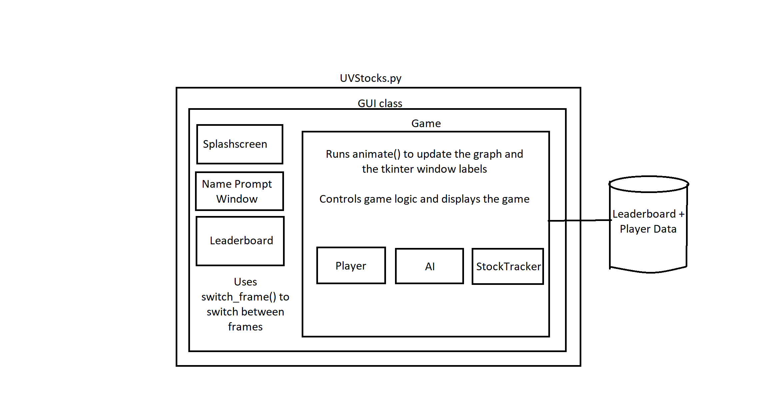

Slide 3
Trent
I learned:
Source control
Architecture for larger(ish) programs
Tkinter
UI Software design and patterns
I did:
Architecture + design

Slide 4
Josue
I learned:
GitHub
Classes interactions
Large projects
I did:
Player score saving system and the Score updater for the game

Slide 5
Jared
I learned:
A lot about python generators
Also learned some cool things about UI design patterns
I did:
the stock price generation - Originally, I used a python generator, but later switched to a class

Slide 6
Kyler
I learned:
How to use GitHub with a team
How to create a GUI using Tkinter
I did:
The leaderboard
The splash screen image + page
Error checking to our buy and sell functions

